Slide 1


NBA Player Stats Using Linear Regression
Temuujin Dorjbat
Bana320
W, 7:00-9:45 PM
Prof. Gupta

Slide 2

Problem Statement
When examining NBA player statistics, it is vital to have a thorough understanding of the many factors that impact a player's Points Per Game (PPG). Although PPG is a basic indicator of a player's scoring capacity, the specific contributions of other performance indicators remain unclear. This research aims to investigate the relationships between PPG and a set of other relevant variables, including playtime, shooting efficiency, rebounding, and defensive statistics.
Source of data: https://www.kaggle.com/datasets/vivovinco/20222023-nba-player-stats-regular

Slide 3
Data Understanding
Variables:
Target Variable: PTS (Points Per Game)
Independent Variables:GS (Games Played)
MP (Minutes Played)
FG (Field Goal Attempts)
3P% (3-point FG Percentage)
ETC…

Slide 4
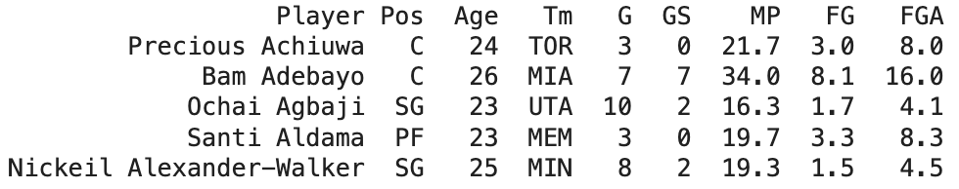
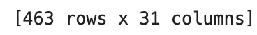
Data Preperation

Slide 5
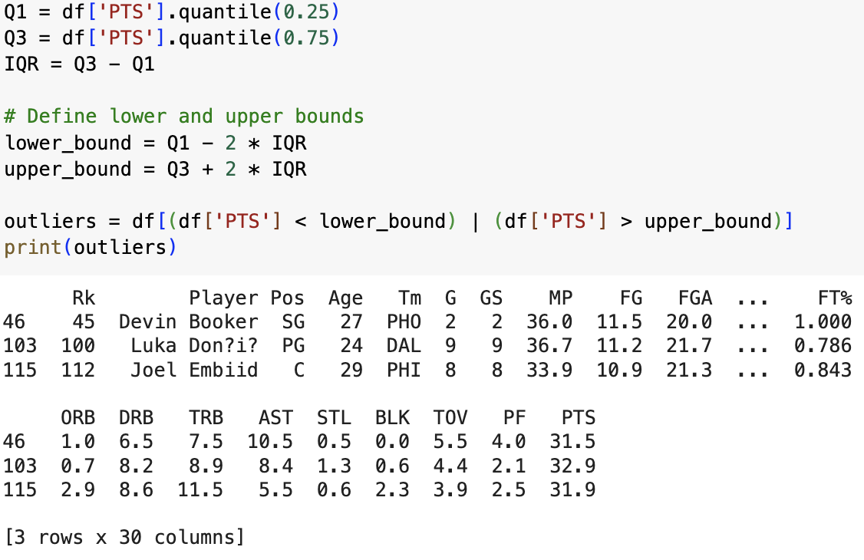
Data Preperation
Managing Outliers

Slide 6
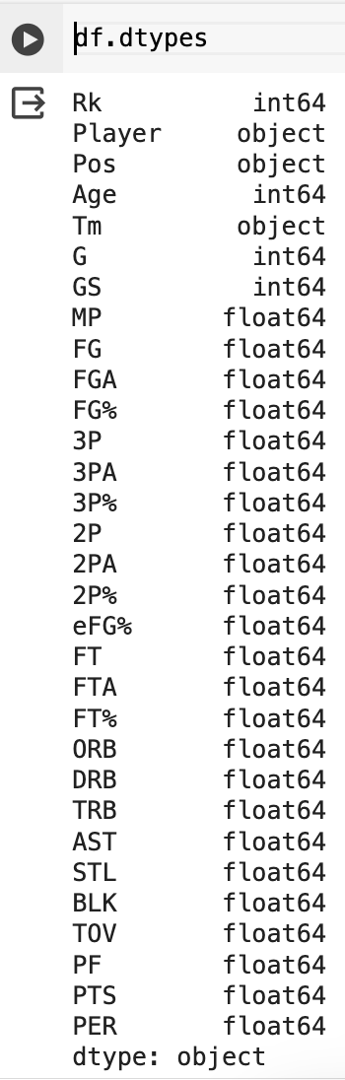
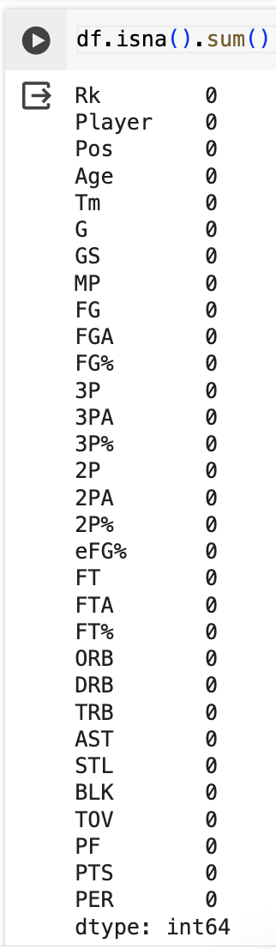
Data Preperation
Managing Data Types
And Missing Values

Slide 7
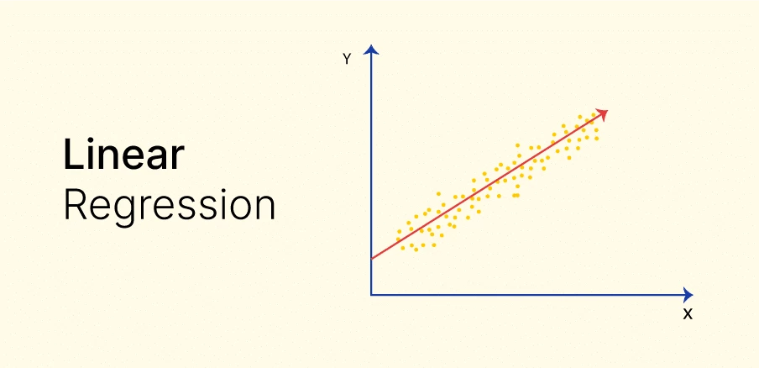
Modeling

Slide 8
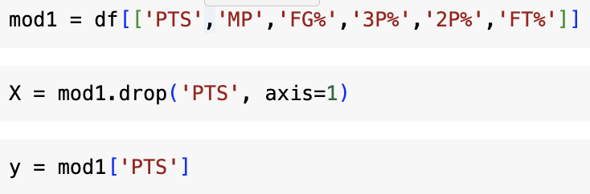
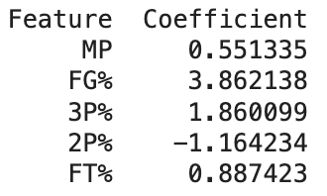
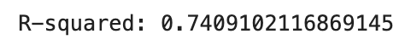
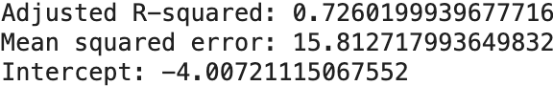
Model 1

Slide 9
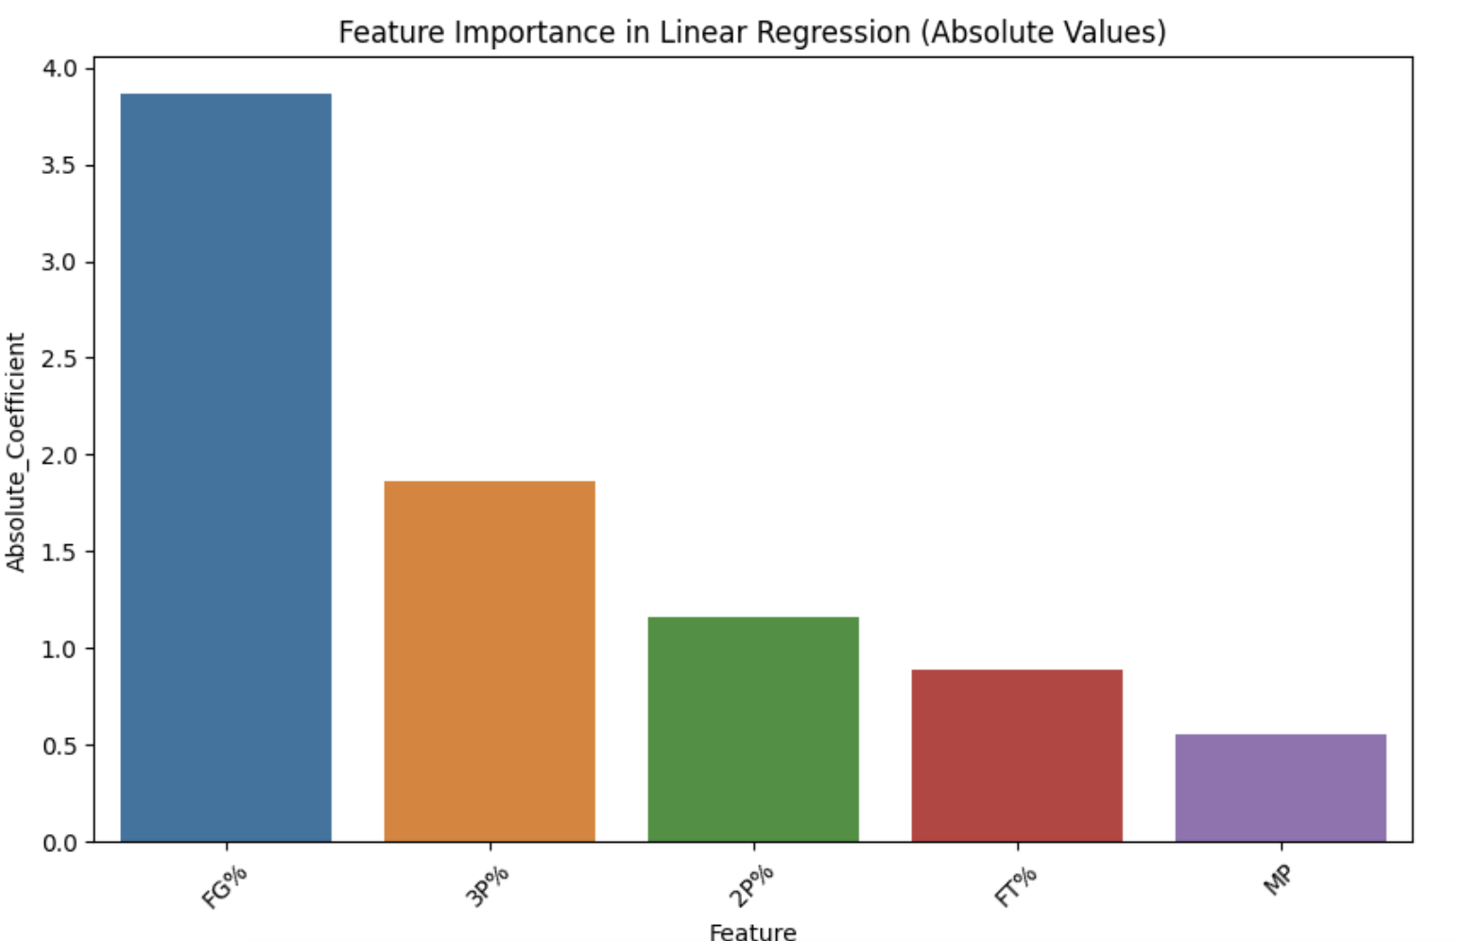
Model 1

Slide 10
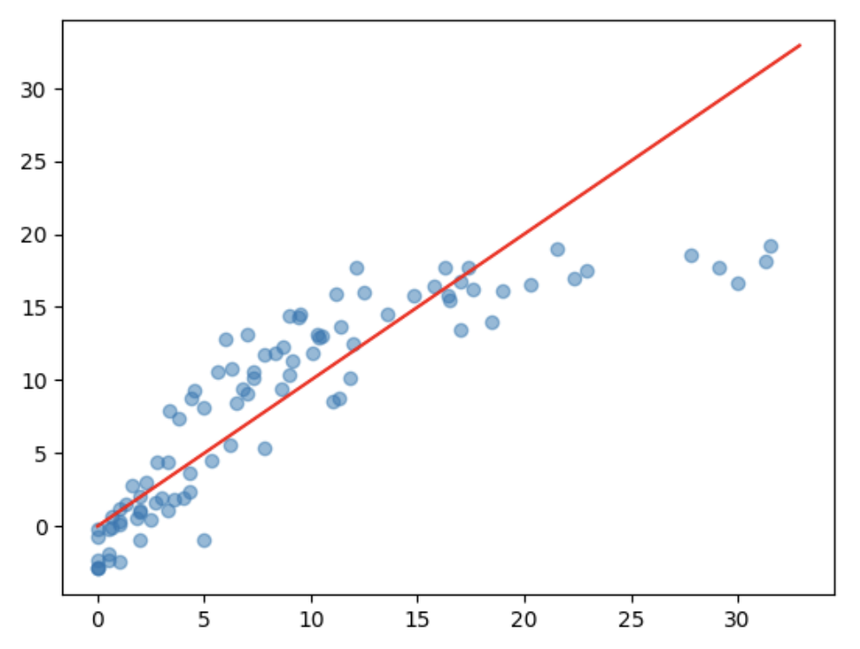
Model 1
Predicted Values
Actual Values

Slide 11
Model 1
Linear Regression Equation
PTS=(−4.0072)+0.551335×MP+3.862138×FG%+1.860099×3P%−1.164234×2P%+0.887423×FT%

Slide 12
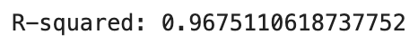
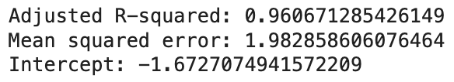
Model 2

Slide 13
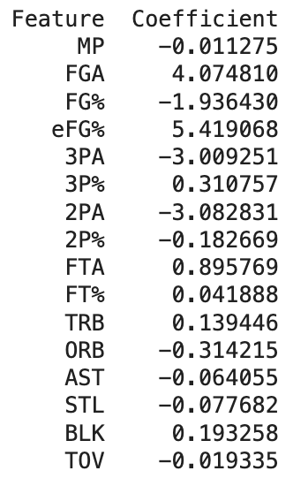
Insight #1
Model 2 Coef
Model 1 Coef

Slide 14
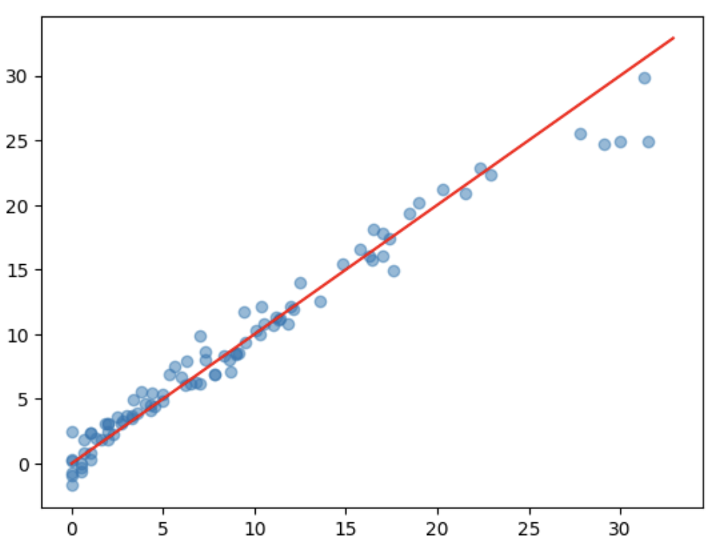
Model 2

Slide 15
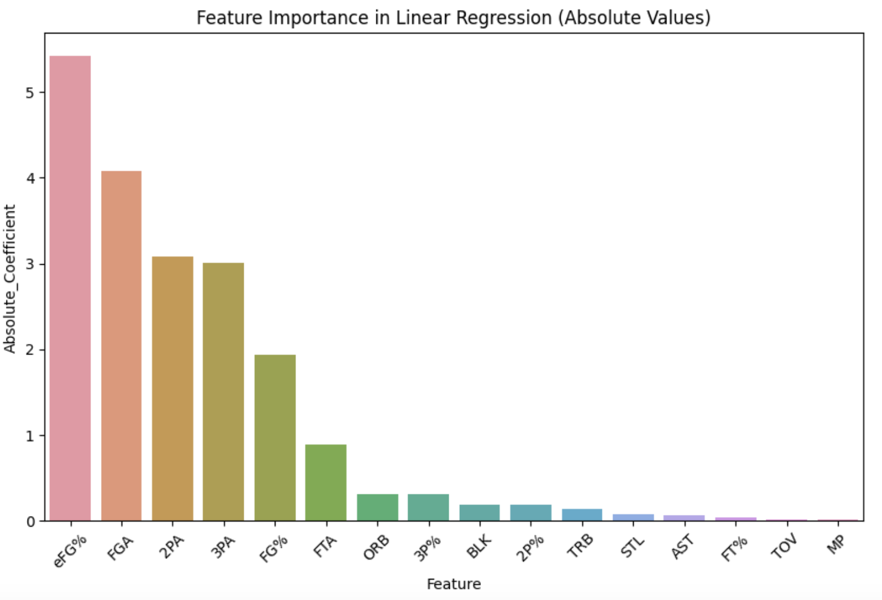
Model 2

Slide 16
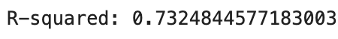
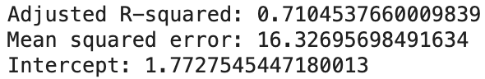
Model 3

Slide 17
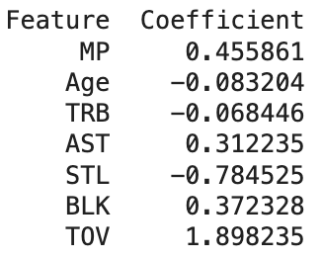
Model 3

Slide 18
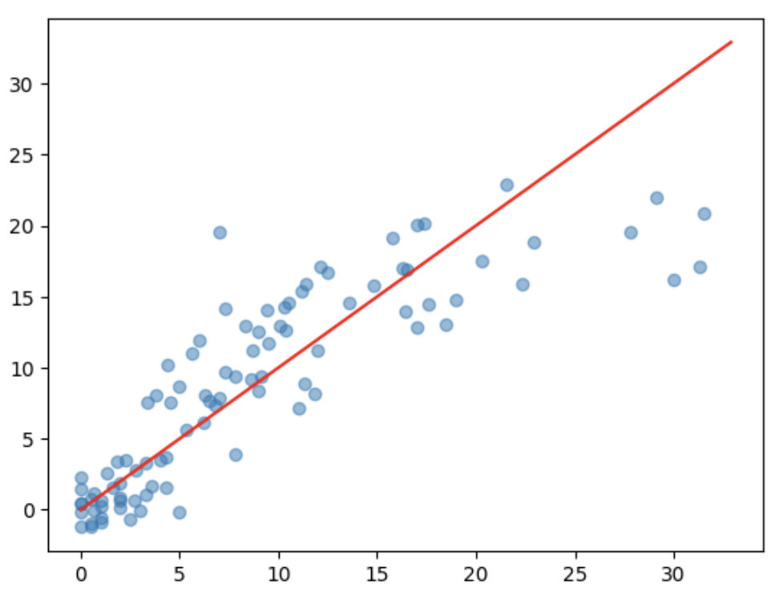
Model 3

Slide 19
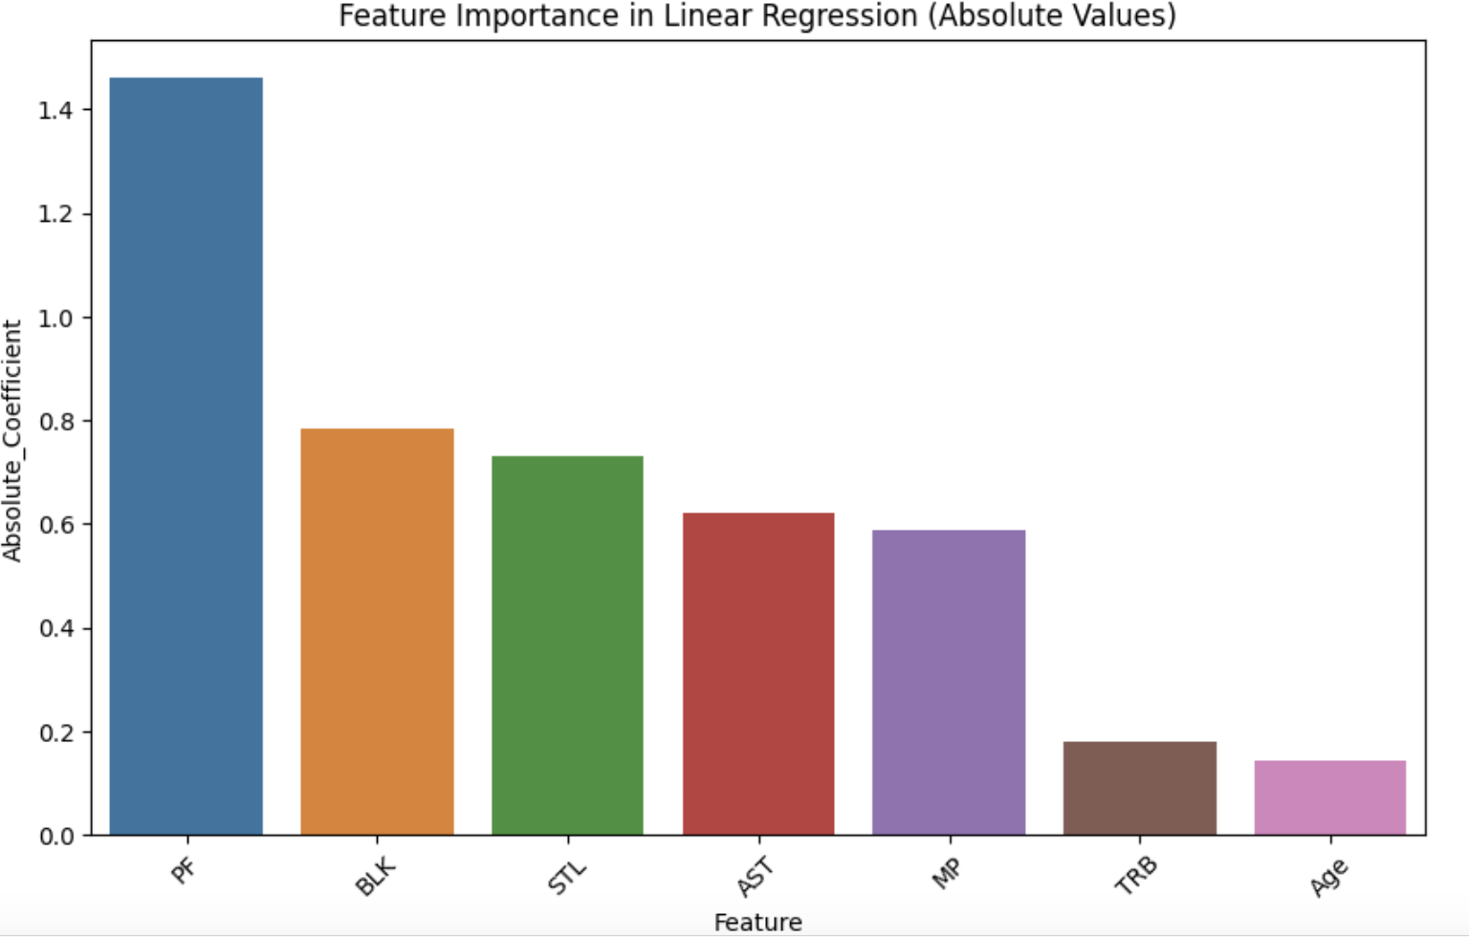
Model 3

Slide 20
Model Comparisons

Slide 21
Model Comparisons

Slide 22
Model Comparisons

Slide 23
Insight #2
Model 1 Most Contributing Variable: FG%
Model 2 Most Contributing Variable: eFG%
Model 3 Most Contributing Variable: PF

Slide 24

THE END

